Slide 1
Final Year Project On
Improving Speech by Analyzing Speech
Under the Guidance of
Mr. Saroj Shakya, Associate Professor
Presented by: Ayush Bajgai

Slide 2
Contents
Project Summary
Design and Implementation
Introduction
Snapshots of the system
Problem Statement
Literature and Technology review
Objectives
Project and Product Evaluation
Methodology
Conclusion
System Requirement
Reference

Slide 3
Project Summary
The goal of the project title is to develop an android application that can help people enhance
their public speaking skills
Android application “Speech to Action”
Build confidence
Able to practice in safer environment

Slide 4

Introduction
Public Speaking became the general, usually neutral term for non-elocutionist oral
communication (Keith, 2008).
“Speech to Action” - transcribes users speech
Provides description and suggestions
Developed using Java and XML

Slide 5
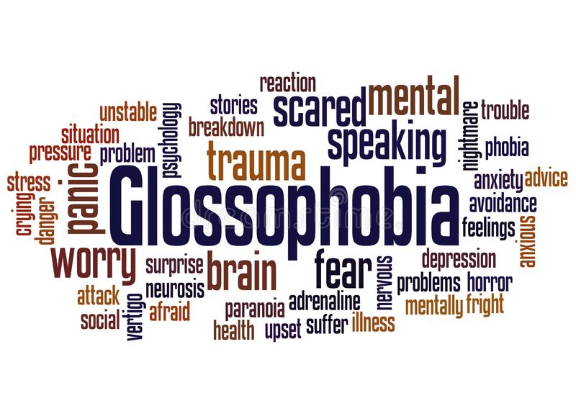
Problem Statement
Fear of speaking in public
Problem writing the contents
“suffer through them with shaking hands and a
quavering voice” (Mayo Clinic, 2022)
Forgetting the lines while delivering
Judged by peers

Slide 6
Objectives
Suggest user in enhancing vocabulary
Opportunity to become a better speaker
Top Stores in app, reading & skimming skills
Avoids repetition words
Checking punctuality

Slide 7
Methodology
Waterfall methodology – phase of SDLC, sequential development process
Includes Requirements, Analysis, Design, Implementation, Testing, Deployment,
Maintenance
Approached in this project because it is cost effective, limited resource, less
manpower while developing
Well Tested and Deployed
Downsides – project requirement changes frequently, leads to rise of bugs

Slide 8
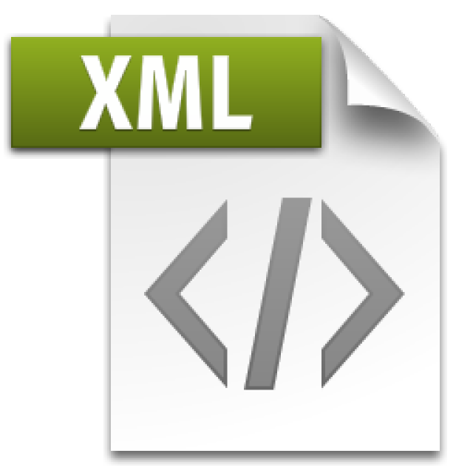
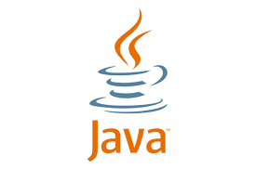
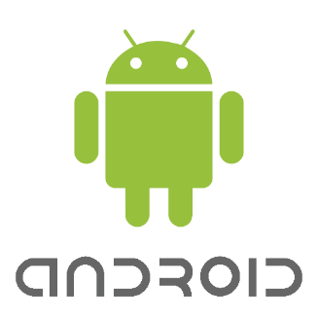
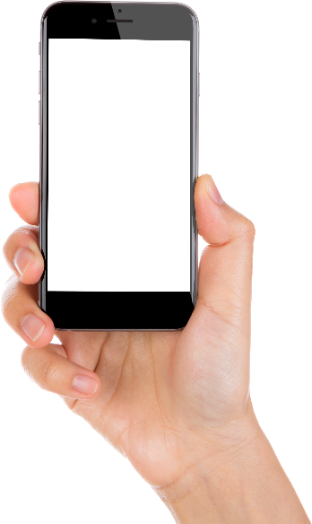
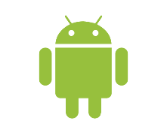

System Requirement
System requirements are the configurations that a system must have in order for a hardware or software program to perform smoothly and efficiently (Techopedia, 2022). The system requirements for this application are very straightforward.

Slide 9
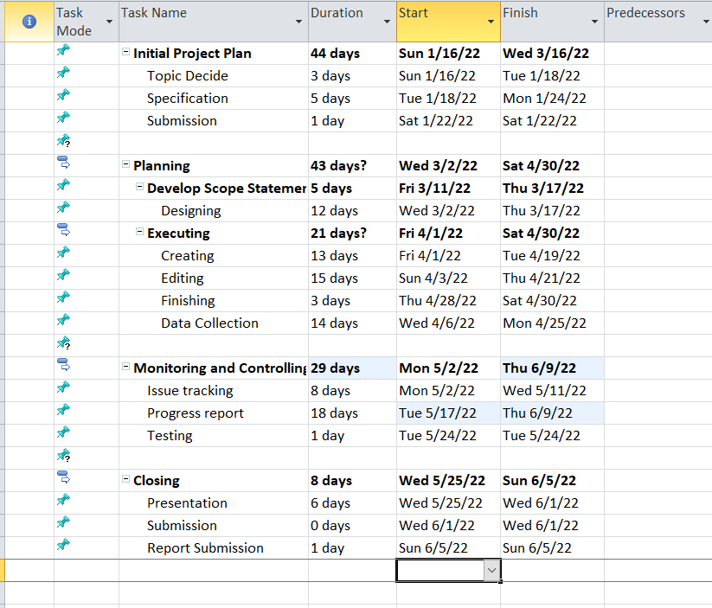
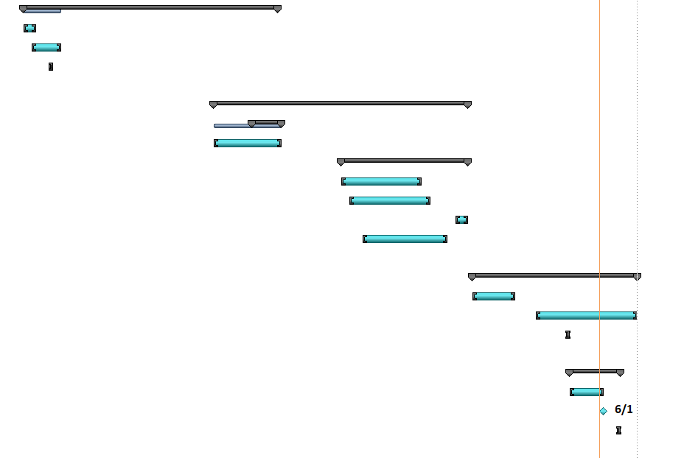
Work Plan
Gantt Chart

Slide 10
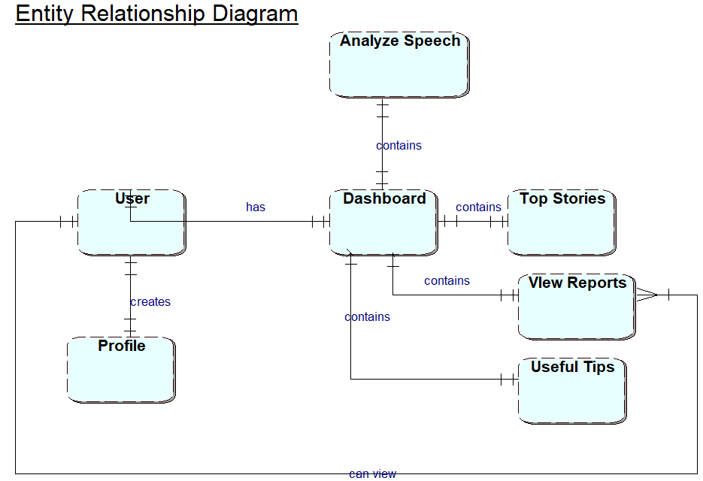
Speech to action ERD

Slide 11
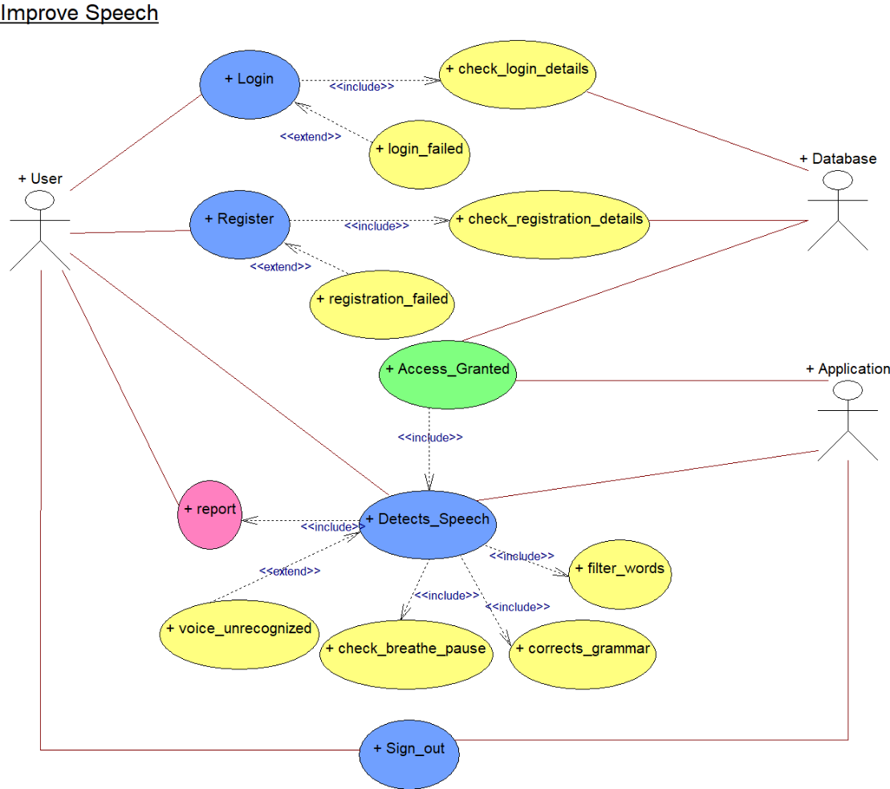
Design and Implementation
Speech to Action
UML of
Speech to Action

Slide 12
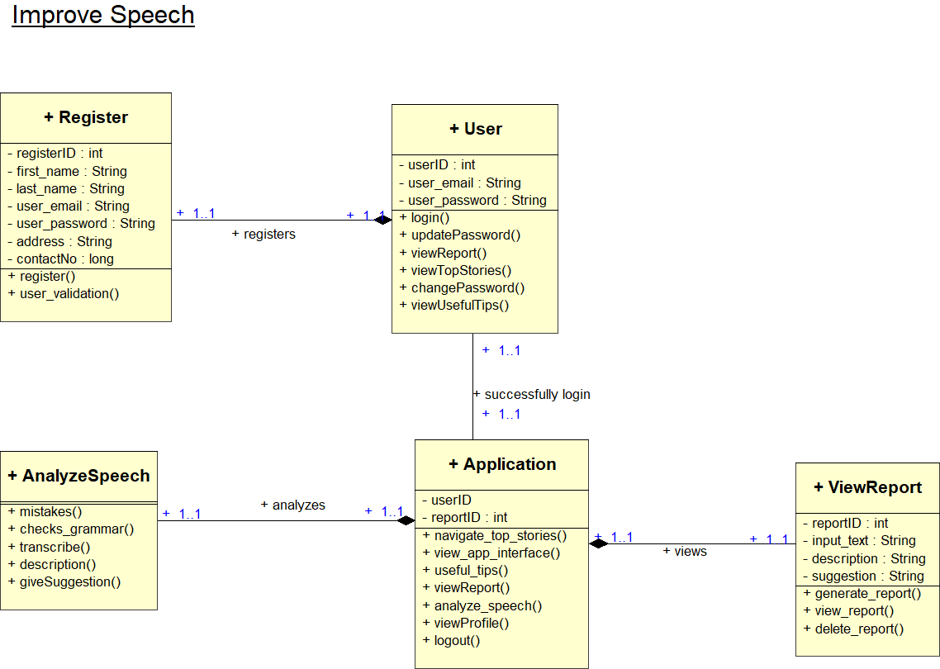
Speech to Action
Class Diagram of Speech to Action

Slide 13
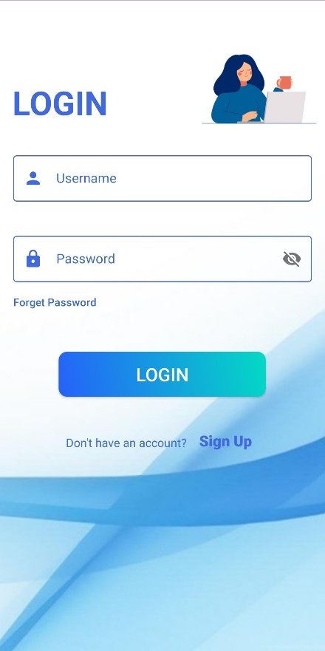
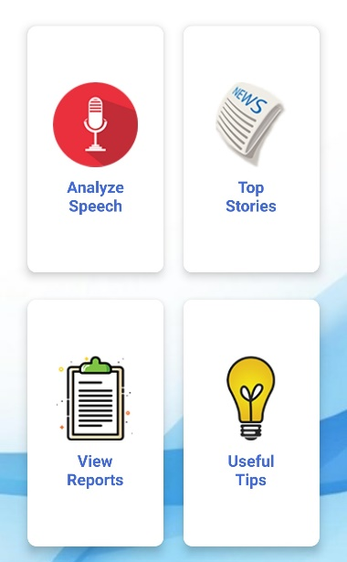
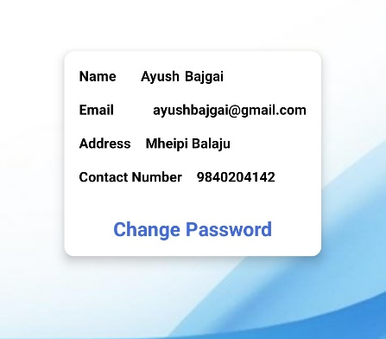
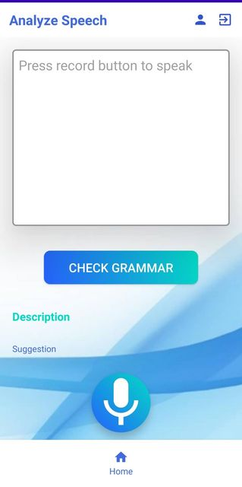
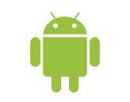
Snapshots
of the System

Slide 14
Literature and Technology review
Android is a linux-based software package and operating system for mobile
devices like tablets and smartphones (javatpoint, 2022)
There is a significant need for mobile device software
To provide user with thorough knowledge
Google Speech Recognition – it’s own library
To convey the message what individuals are saying
Easy-to-understand format, Simple layout, Accessible and well portrayed

Slide 15
Product Evaluation
Based on initial project plan
Product fulfills the requirement such as :-
transcribing speech to text
gives feedback
view profile
forget password
Properly Tested and Deployed

Slide 16
Project Evaluation
Simple functionality – expense of having a usable system
Completed following the key aspects of the requirements and methodology
Every component of the methodology is appropriate for the project.
Replacing the existing systems which are too complicated
Built from scratch for the betterment of simple interface, system efficient and cooperative modules
Has adverse limitations while developing the application

Slide 17
Limitation
The application is not designed to work with different languages, accents or dialects
Restrictions - For example, it can't understand words that aren't in its dictionary
The speech-to-text system is not completely accurate transcribing speech to text
Requires peaceful surroundings
Doesn’t provide suggestions for correct grammars

Slide 18
Conclusion
“Speech to Action” an application - which helps and guide every person
It explains the system's goals, functionality, and interface.
Java – a general programming language, object-oriented language
Different task and different scenarios to cope with
Collected development and management information.

Slide 19
Reference
JavaTpoint, 2022. What is android - javatpoint. [online] Available at: <https://www.javatpoint.com/android-what-where-and-why> [Accessed 1 May 2022].
Keith, W., 2008. On the Origins of Speech as a Discipline: James A. Winans and Public Speaking as Practical Democracy. Rhetoric Society Quarterly, 38(3), pp.239-258 [Accessed 13 05 2022]
Mayo Clinic. 2022. Fear of public speaking: How can I overcome it?. [online] Available at: <https://www.mayoclinic.org/diseases-conditions/specific-phobias/expert-answers/fear-of-public-speaking/faq-20058416#:~:text=D.%2C%20L.P.,hands%20and%20a%20quavering%20voice.> [Accessed 31 May 2022].
Techopedia, 2022. What are System Requirements? - Definition from Techopedia. [online] Available at: <https://www.techopedia.com/definition/4371/system-requirements> [Accessed 31 May 2022].

Slide 20
Thank you

